Slide 1
Classroom Management and Laboratory Safety
PHILIP A. REED, PHD

Slide 2
Objectives
Review state and professional resources
Discuss laboratory management strategies
View select websites
Discussion

Slide 3
Virginia Department of Education https://www.doe.virginia.gov/instruction/career_technical/index.shtml
CTE program pages
Safety Best Practice Guide for CTE
Personal Protective Equipment (PPE)
Safety Data Sheets (SDS; formerly MSDS)
CDC/NIOSH/Virginia safety curriculum: https://www.cdc.gov/niosh/talkingsafety/states/va/2015-161/default.html
Approved equipment lists for programs

Slide 4
Virginia’s CTE Resource Center https://www.cteresource.org/
Courses organized in Canvas
Competencies and Student Competency Records (SCR)
Lessons and activities
Credential and Cluster/Pathway information
Student and parent resources
Work-based learning resources

Slide 5
Career and Technical Student Organizations (CTSOs)
DECA | http://www.deca.org http://www.vadeca.org
Educators Rising | https://educatorsrising.org/
FFA | http://www.ffa.org/ http://www.vaffa.org/
HOSA | http://www.hosa.org/ http://www.virginia-hosa.org/
FBLA | https://www.fbla-pbl.org/ https://www.vafbla-pbl.org/
FCCLA | http://www.fcclainc.org/ https://virginiafccla.org/
TSA | https://tsaweb.org/ https://tsavirginia.org/
Skills USA | http://www.skillsusa.org/ https://www.skillsusava.org/

Slide 6
Technology Student Association (TSA)
Use officer structure for class leadership
Instructional resources via competitive events and leadership activities
Advisor mentoring/community

Slide 7
Professional Organizations
State organization conferences (i.e., https://www.vteea.org/)
Safety pages and guides
PD for micro credentials/badges
Open access curriculum
Example: International Technology and Engineering Educators Association (https://www.iteea.org/)

Slide 8
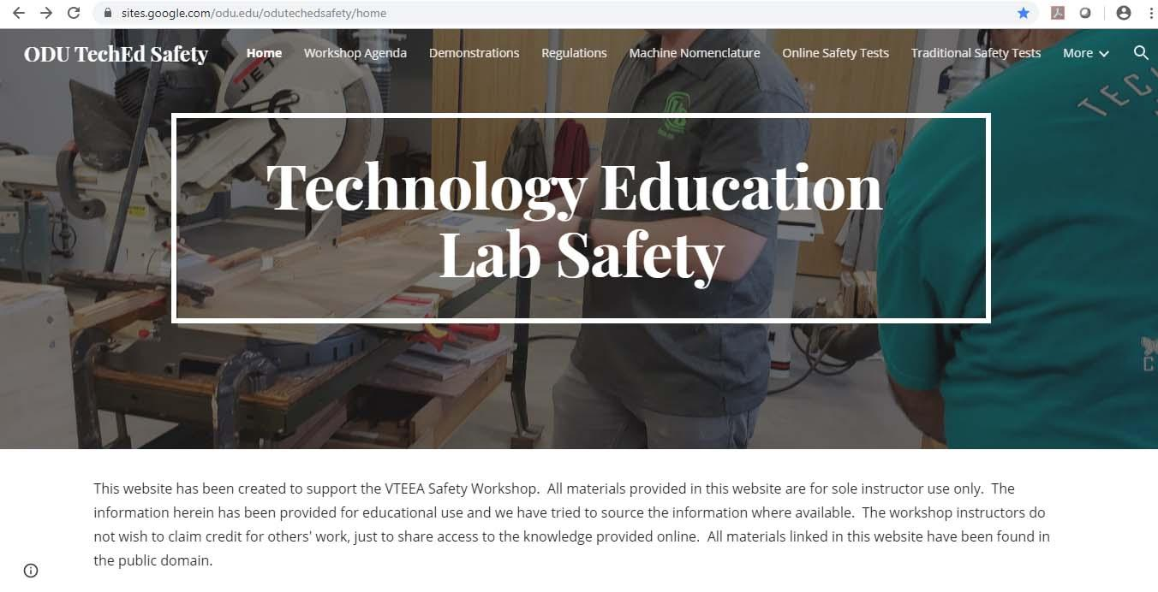
ODU Technology Ed. Safety Site https://sites.google.com/odu.edu/odutechedsafety/home

Slide 9
General Laboratory Management
Clean and organize relentlessly at the beginning of each term
Create signs and visual aids
Use bins, labels, contact paper, etc. for visual management
Have secure tool/material storage and other tool/material storage for student access/responsibility

Slide 10
General Laboratory Management
Have a plan for everything… tools, materials, projects, cleaning, visitors, etc.
…most importantly: students!
Educate for ownership
Crosstrain and rotate

Slide 11
Website Overviews & Discussion
Philip A. Reed, Ph.D.
Old Dominion University 4121 Education Building Norfolk, Virginia 23529-0157 757-683-4576 preed@odu.edu

